Slide 1


Project Pitch

Slide 2
What’s the issue?
Most people are busy and don’t have the time to fumble around looking for recipes – TIME = MONEY
Keeping track of your favorites recipes is usually cumbersome, involving lots of lost or hard to recreate recipes

Slide 3
Statement of Purpose
Where does CreATE fit in?

Slide 4
Fast and easy way to search for recipes
Allow users to add and save all their recipes in one place in an ordered clear and uniform manner.
Provide an easy platform to share recipes with friends
Make cooking and diversifying your pallet a simple and quick task, even when on a tight time constraint!

Slide 5
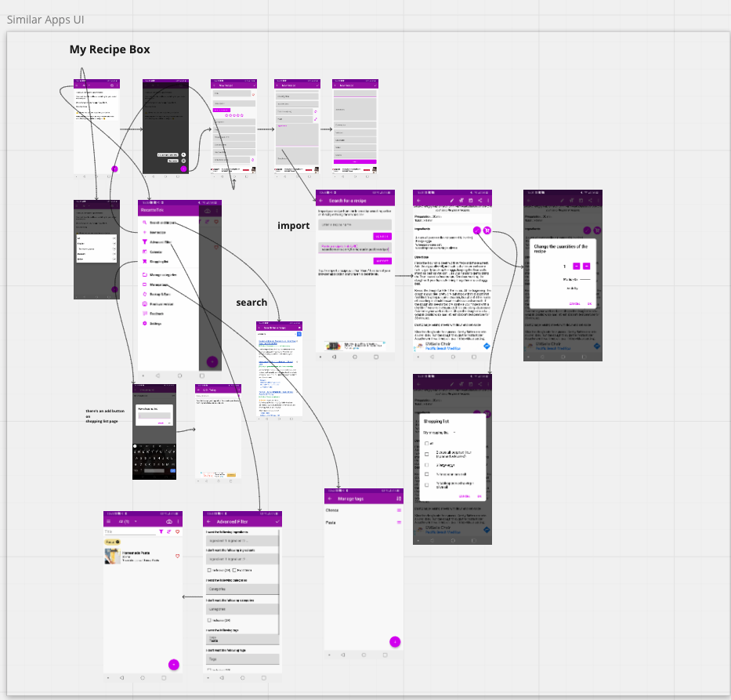
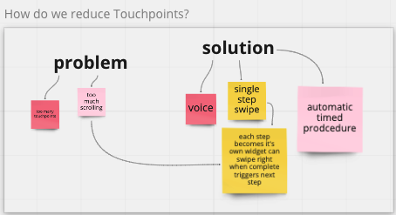
Research

Slide 6
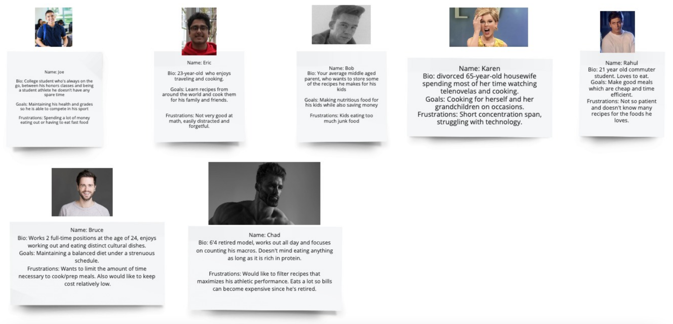
User Personas

Slide 7
Risks and Rabbit Holes
Main constraint of our project is our limited time
Rabbit Holes
Wanted feature to import recipes but didn’t know how → Concern if this is feasible given our time limit
Lab 6 helped us learn how to do this, now it seems possible to implement
Vague feature idea of sharing recipes
Implement by users creating accounts and other accounts can access their recipe with links
Design idea to highlight one recipe step at a time so it’s easier to read
This design doesn’t align with the goal to make app usability as touch-free as possible, so we scrapped it
Out of bounds:
As the purpose of this app is to manage recipes, working on solutions like food logs, diet tracker, calorie counter, etc. are out of our scope
Cut Back:
Don’t add unnecessary features that we wouldn’t be able to complete in the time given
Where to buy ingredients
Speech to text

Slide 8
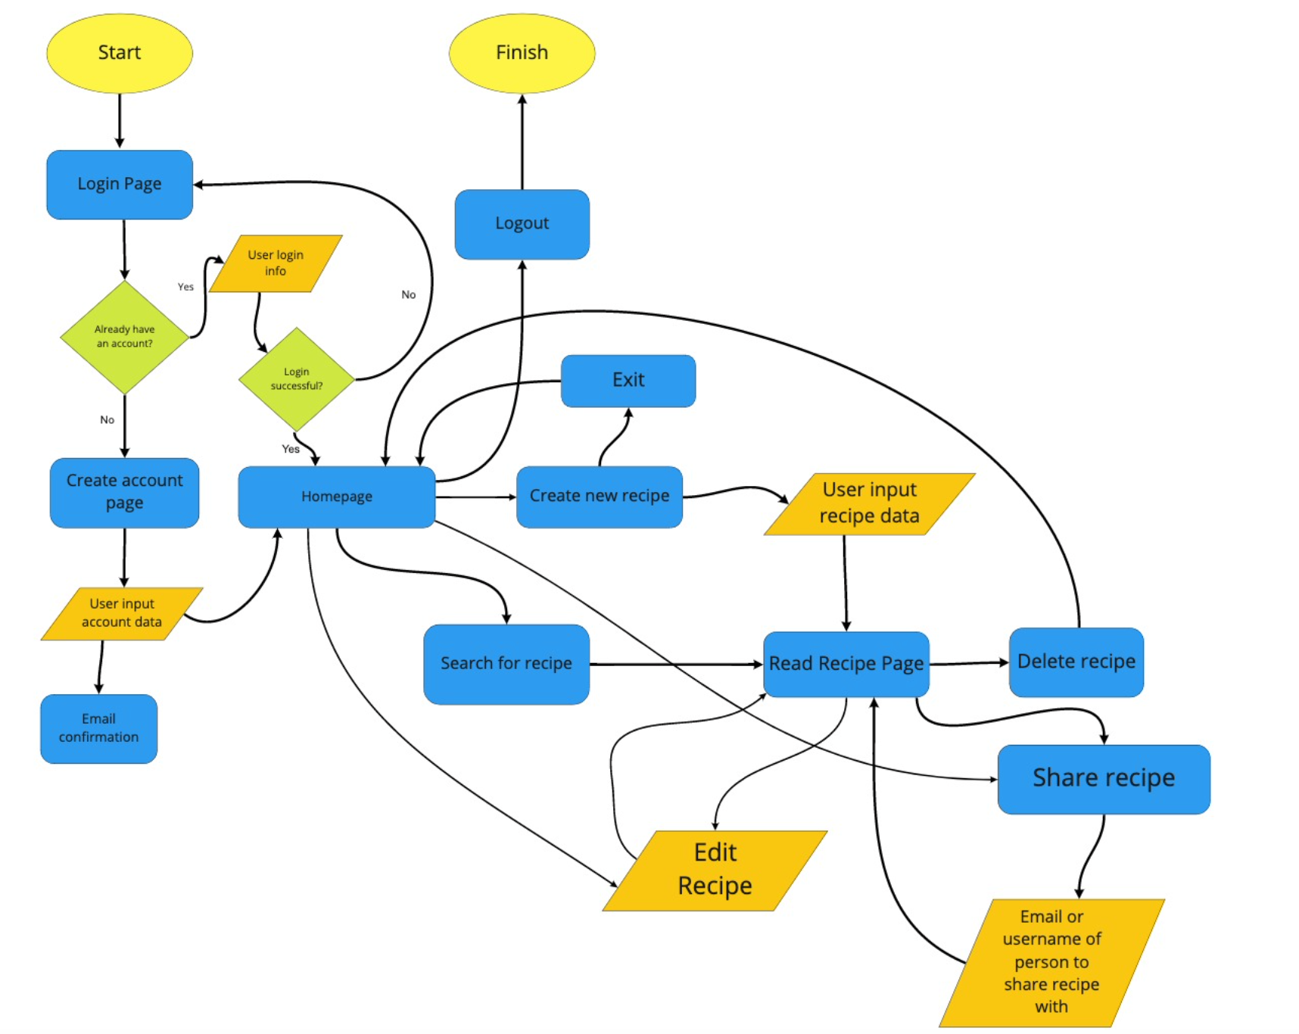
System Diagram

Slide 9
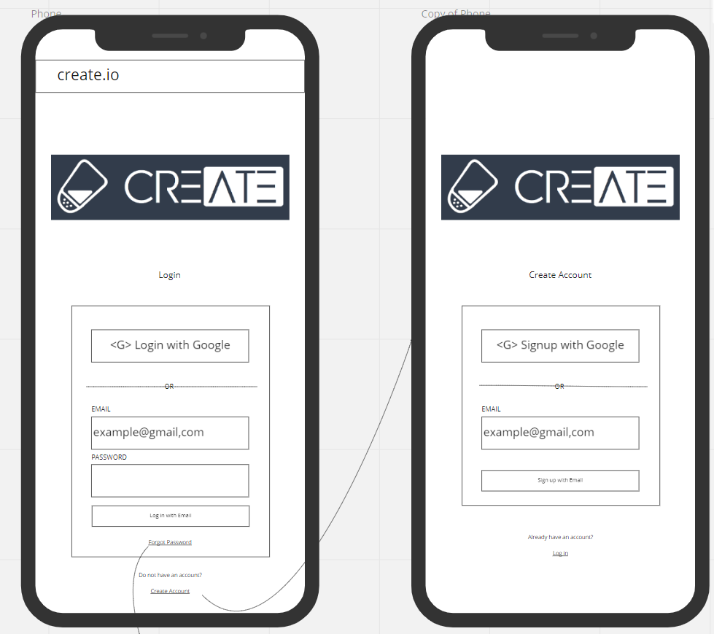
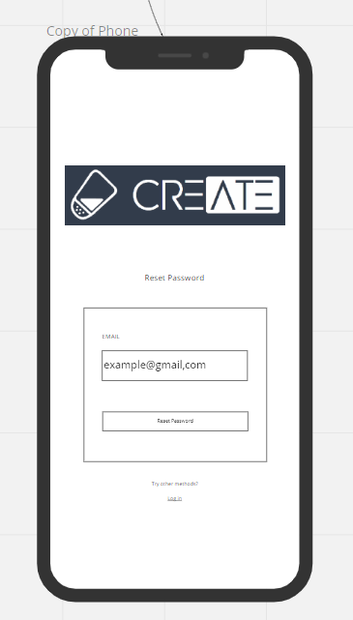
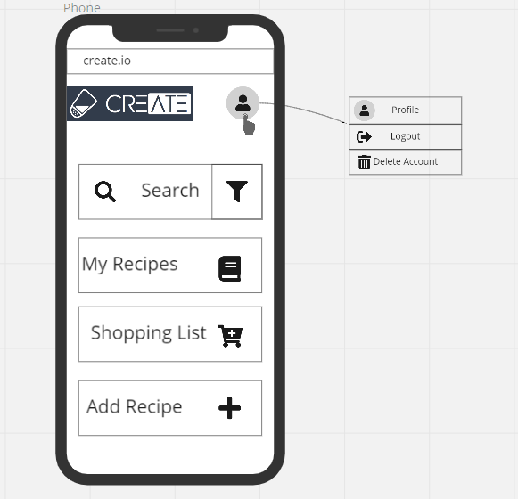
Wireframes
LOGIN
HOME PAGE

Slide 10
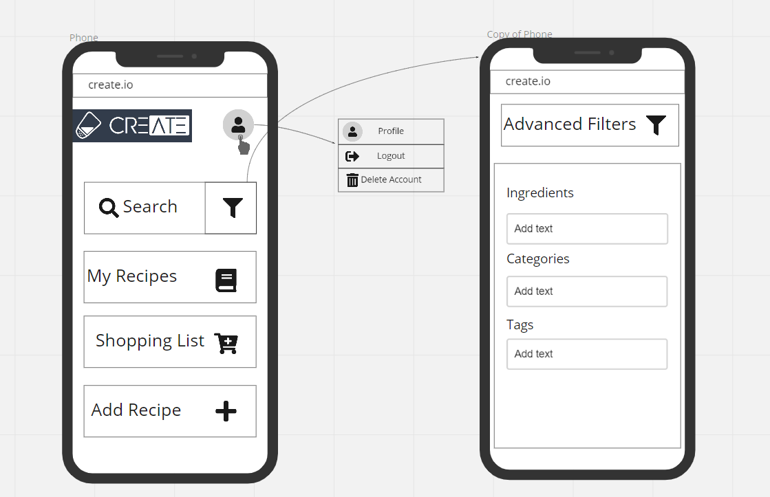
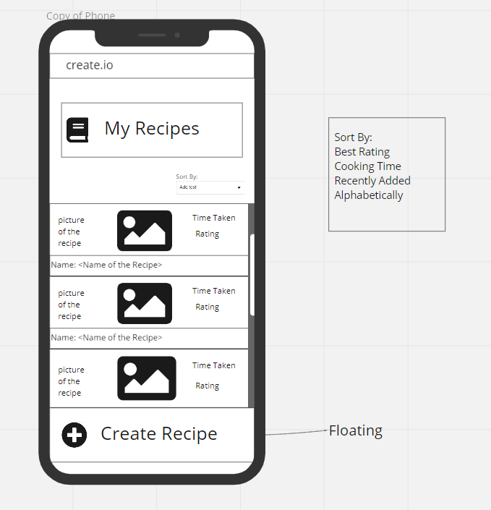
ADVANCED FILTER
RECIPES PAGE

Slide 11
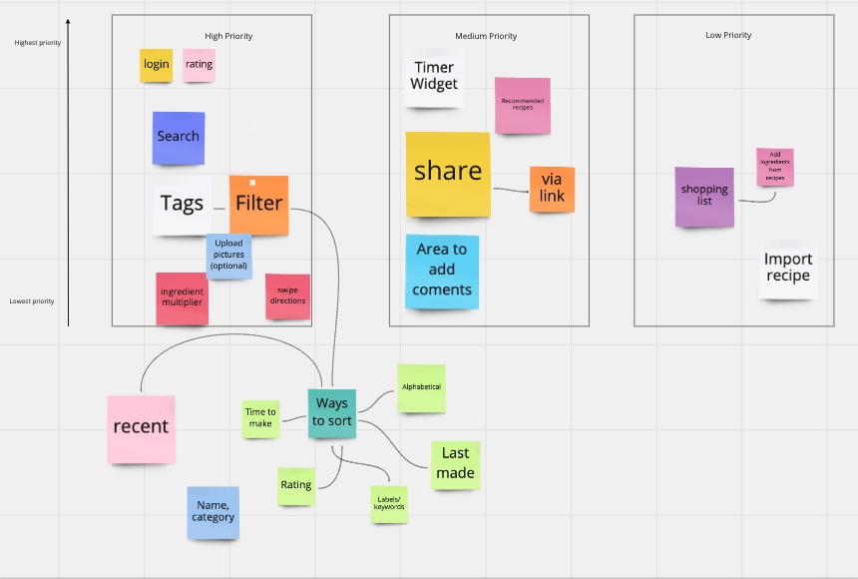
Priority of Features

Slide 12
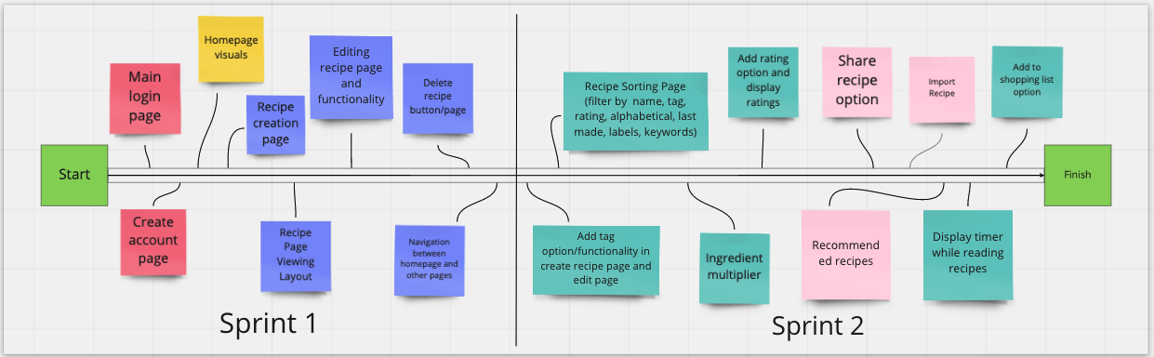
Front-End Timeline

Slide 13
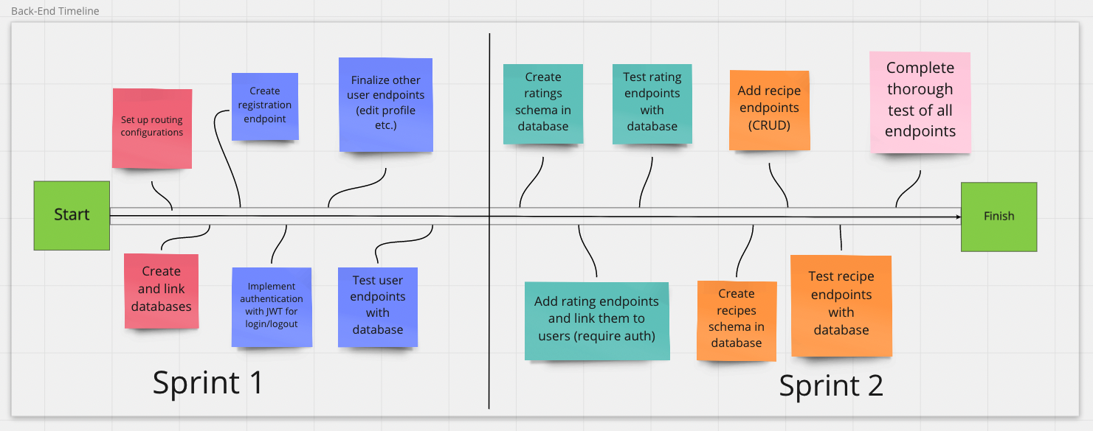
Back-End Timeline

Slide 14
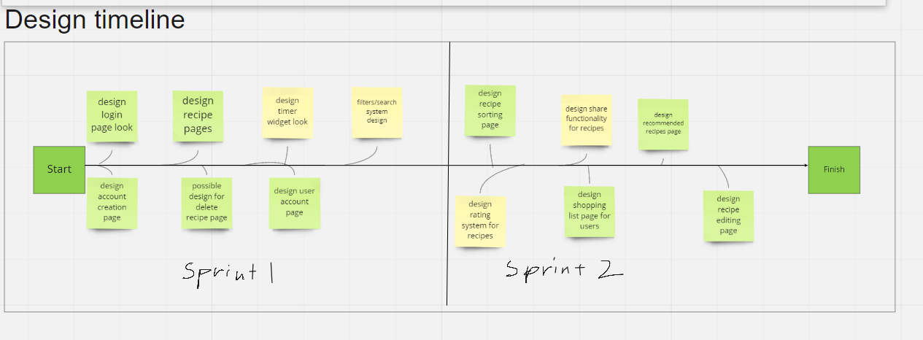
Design Timeline

